Slide 1

Ch.03 Using Arrays
Siva R Jasthi
ICS325 – Internet Application Development
Information and Computer Sciences
Metropolitan State University

Slide 2
Outline
Numerically indexed arrays
Non-numerically indexed arrays
(these are also called associative arrays)
Initializing Arrays
Accessing array elements
Array operators
Multi-dimensional arrays
Array Sorting
Array Functions

Slide 3
Creating Numerically Indexed Arrays
$students = array(‘bob’, ‘mark’, ‘lisa’);
$numbers = range(1,10);
$odd_numbers = range(1,10, 2);
$letters = range(‘a’, ‘z’);
You can also load data from files and database directly into Arrays.

Slide 4
Accessing Numerically Indexed Arrays
Same as C++ or java
First element is at index 0
$students = array(‘bob’, ‘mark’, ‘lisa’);
$students[0] is bob
$students[1] is mark.
You can also change the values in array in similar fashion
$students[1] = ‘george’ (the value ‘mark’ is now replaced by ‘george’)

Slide 5
Using loops to access the array elements
Traditional for loop:
$students = array(‘bob’, ‘mark’, ‘lisa’);
for ($i=0; $i<3; $i++)
{
echo $students[i];
}
Enhanced foreach loop:
$students = array(‘bob’, ‘mark’, ‘lisa’);
foreach ($students as $student)
{
echo $student.” “;
}
Arrays / Collections are named “plural”.
Array elements are named “singular”.
Following this convention will help in improving the readability.

Slide 6
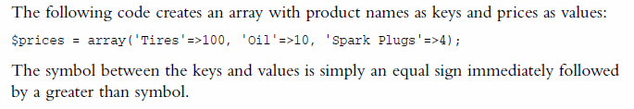


Creating Associative Arrays
Numerically indexed arrays have default keys numbered as 0,1,2 and so on.
Associative arrays lets you define your own keys. (Recall Hashtables and Hashmaps in java; Dictionaries in Python)
Same array can also be created as follows.

Slide 7
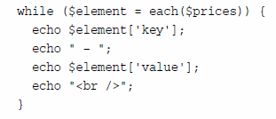


Accessing Associative Arrays
You can not use a simple for loop (because there are no numerical indexes) for accessing an associative array.
However, you can use one of the three methods to access elements in associative arrays (a) foreach (b) each (c) list

Slide 8
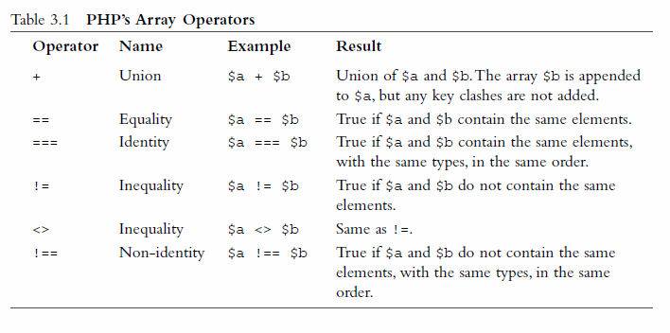

PHP’s Array Operators

Slide 9
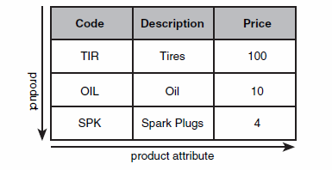

An array of arrays = Multi-Dimensional Array
You can create an array of arrays (multi-dimensional arrays = matrix = grid).

Slide 10

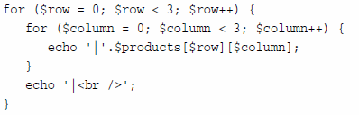

Accessing multi-dimensional arrays
You need two indexes
[0,0] is the top left
Is (1st row & 1st column)
Two indexes
Nested for loop
Both versions produce

Slide 11
Using associative arrays for Multi-Dimensional arrays
Same as before but keys are defined in lieu of default numerical indexes
$products = array ( array ( 'Code' => 'TIR',
'Description' => 'Tire',
'Price' => 100
),
array ( 'Code' => 'OIL',
'Description' => 'Oil',
'Price' => 10
),
array ( 'Code' => 'SPK',
'Description' => 'Spark Plugs',
'Price' => 4
)
)

Slide 12
Sorting Arrays in PHP
PHP has several functions that deal with sorting arrays, and this document exists to help sort it all out. The main differences are:
Some sort based on the array keys, whereas others by the values: $array['key'] = 'value';
Whether or not the correlation between the keys and values are maintained after the sort, which may mean the keys are reset numerically (0,1,2 ...)
The order of the sort: alphabetical, low to high (ascending), high to low (descending), numerical, natural, random, or user defined
Note: All of these sort functions act directly on the array variable itself, as opposed to returning a new sorted array
If any of these sort functions evaluates two members as equal then the order is undefined (the sorting is not stable).

Slide 13
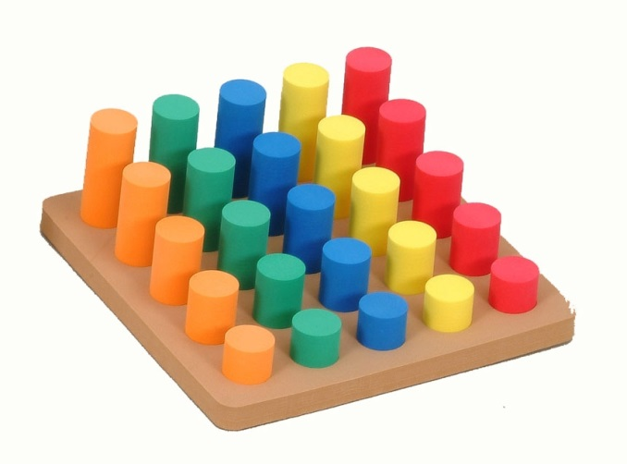
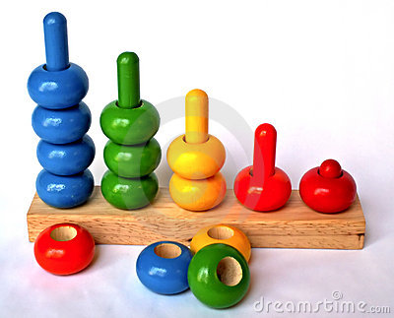
Some typical sorting functions in PHP
sort() - sort arrays in ascending order
rsort() - sort arrays in descending order
asort() - sort associative arrays in ascending order, according to the value
ksort() - sort associative arrays in ascending order, according to the key
arsort() - sort associative arrays in descending order, according to the value
krsort() - sort associative arrays in descending order, according to the key

Slide 14
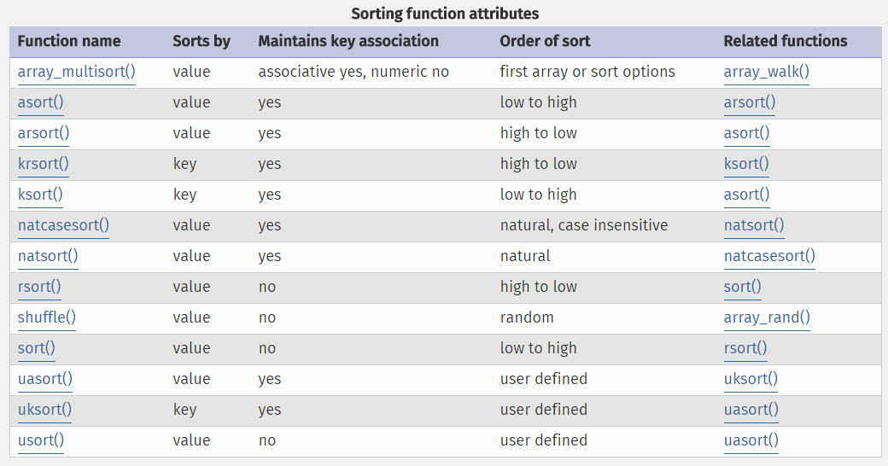
Sorting Arrays in PHP

Slide 15
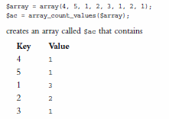
Many functions for array manipulation
Let us walk through PHP Manual for array functions.
http://php.net/manual/en/ref.array.php
For reordering an array (reverse, shuffle)
For navigating an array (each, current, reset, end, next, pos, prev)
For counting / sizing an array (count, sizeof, array_count_values)
Applying a function to each element (array_walk)
String and array connections (explode, implode)
Deleting an array (unset)
array_count_values returns the frequency table of an array.

Slide 16
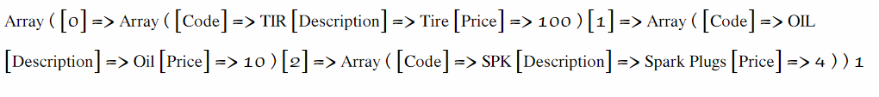
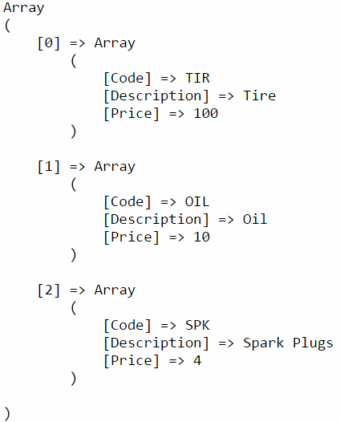
Some tips to print arrays (see array1.php)
Printing a variable in human readable format
http://php.net/manual/en/function.print-r.php
Printed by echo $products
As shown in “View Source”
“ View Source” has better formatting that human readable format produced by print-r function

Slide 17
Some tips to print arrays (see array1.php)
Printing a variable in human readable format
http://php.net/manual/en/function.print-r.php
Printed by echo $products
As shown in “View Source”
“ View Source” has better formatting that human readable format produced by print-r function

Slide 18
Some tips to print arrays (see array1.php)
<?php
$products = array ( array ( 'Code' => 'TIR',
'Description' => 'Tire',
'Price' => 100
),
array ( 'Code' => 'OIL',
'Description' => 'Oil',
'Price' => 10
),
array ( 'Code' => 'SPK',
'Description' => 'Spark Plugs',
'Price' => 5
)
);
echo '<br>printing using print_r <br>';
print_r($products);
echo '<br> -------------------------------------------------- <br>';
echo '<br> printing by print_r and preserving the formatting <br>';
echo '<pre>' , print_r($products) , '</pre>';
?>
Adding <pre> </pre> tags will help preserve the formatting of the array.

Slide 19
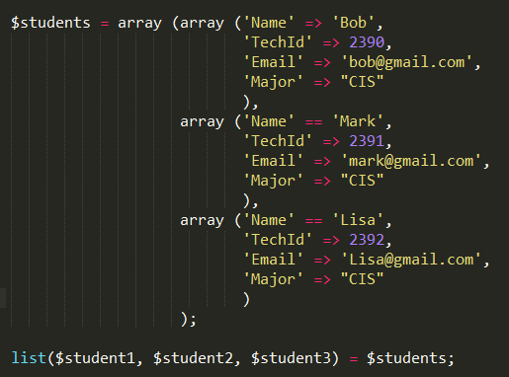
Efficient array access with list( ) construct (see array1.php)

Slide 20
Summary
PHP supports two types of arrays
Numerically indexed arrays
Associate arrays (key – value pairs)
Many functions are available for array creation, manipulation, navigation, sorting. Use PHP built-in functions.
Make use of print_r function with pre tags as a debugging aid.

Slide 21
References
PHP Manual http://php.net/manual/
Array Functions: http://php.net/manual/en/ref.array.php
W3 Schools
http://www.w3schools.com/php/php_arrays_sort.asp
Array Sorting
http://php.net/manual/en/array.sorting.php

